Slide 1

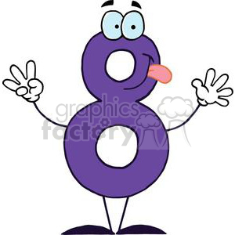
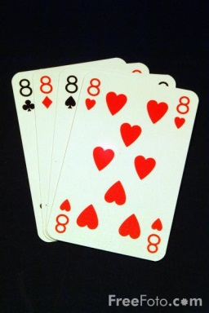

Eight 8s
How can you add eight 8's to get the number 1,000? (only use addition)
Eg 88+8+888….
You can use a calculator to check your answer
Notes:
hook

Slide 2
The Answer
8+8+8+88+888= 1000

Slide 3
24
7
30
Date
Translations
EQ – How can we draw and describe translations
A translation is a SLIDE transformation, where every point is moved the each same distance either left, right, up or down.
3cm
3cm
3cm
A translation right 3cm.
Every point on the triangle needs to move exactly 3 cm to the right
5
Notes:
Lesson objective (EQ)

Slide 4
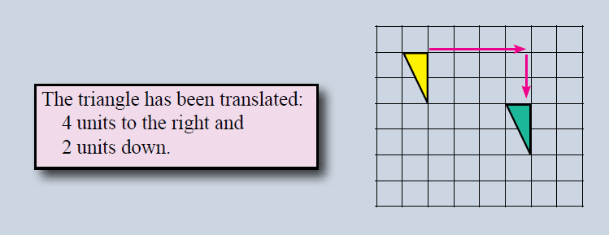
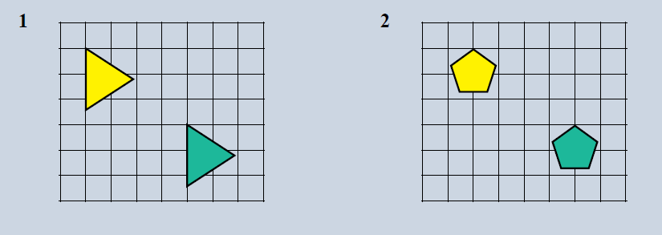
Describe the translation
Notes:
Check for understanding

Slide 5
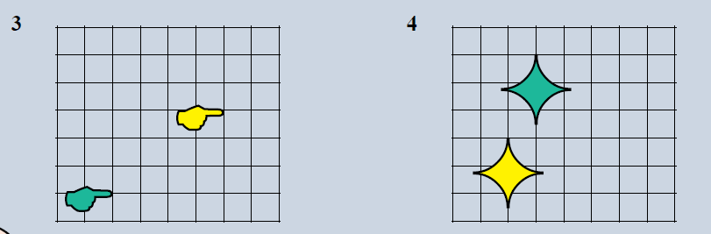
Describe the translation

Slide 6
Translation Activity
You will need
A shape
Graph paper
Start in the top left corner and trace around your shape.
Slide your shape 5 boxes to the right and trace around it.
Check that you have translated it correctly (each corner needs to have moved exactly 5boxes)
Now translate your shape down 10 boxes (check each corner)
Translate your shape 2 boxes left and 4 boxes up
Notes:
Check for understanding

Slide 7
Practice
Complete the practice sheet
Notes:
Independent practice

Slide 8
THINK, PAIR, SHARE
What is a translation?
Write this as your summary
Notes:
Closure

